Slide 1
Physical Properties and Observables of the Warm/Hot IGM
Frits Paerels
Columbia University
and
SRON Utrecht
The Warm and Hot Universe, Columbia, May 7, 2008

Slide 2
Approximate Physical Properties of the WHIM
Deviations from Equilibrium
Which WHIM? The effect of Galactic Winds
X-ray Spectroscopy and Absolute Measurements

Slide 3
1. The WHIM: approximate physical properties
Gravitational collapse: shocks heat the diffuse IGM
½ m_{p}(l H₀)² = 3/2 kT;
l = 1 Mpc: T = 2 x 10⁵ (l /1 Mpc)² h₇₀² K
Detailed DM/Hydro simulations:
- overdensities δ ~ few, to few dozen; but with
large range in density;
- physical density δ <n_{B>} = δ ⋅2 x 10⁻⁷ cm⁻³ (!!)
- average T correlates with δ, but with large spread, 10⁵⁻⁷ K
- metallicity: ??, from Z/Z_{O} = 0.01 (Lyα forest) to 0.3 (clusters);
probably strongly density-dependent
May hold up to ~40% of the baryons at z=0

Slide 4
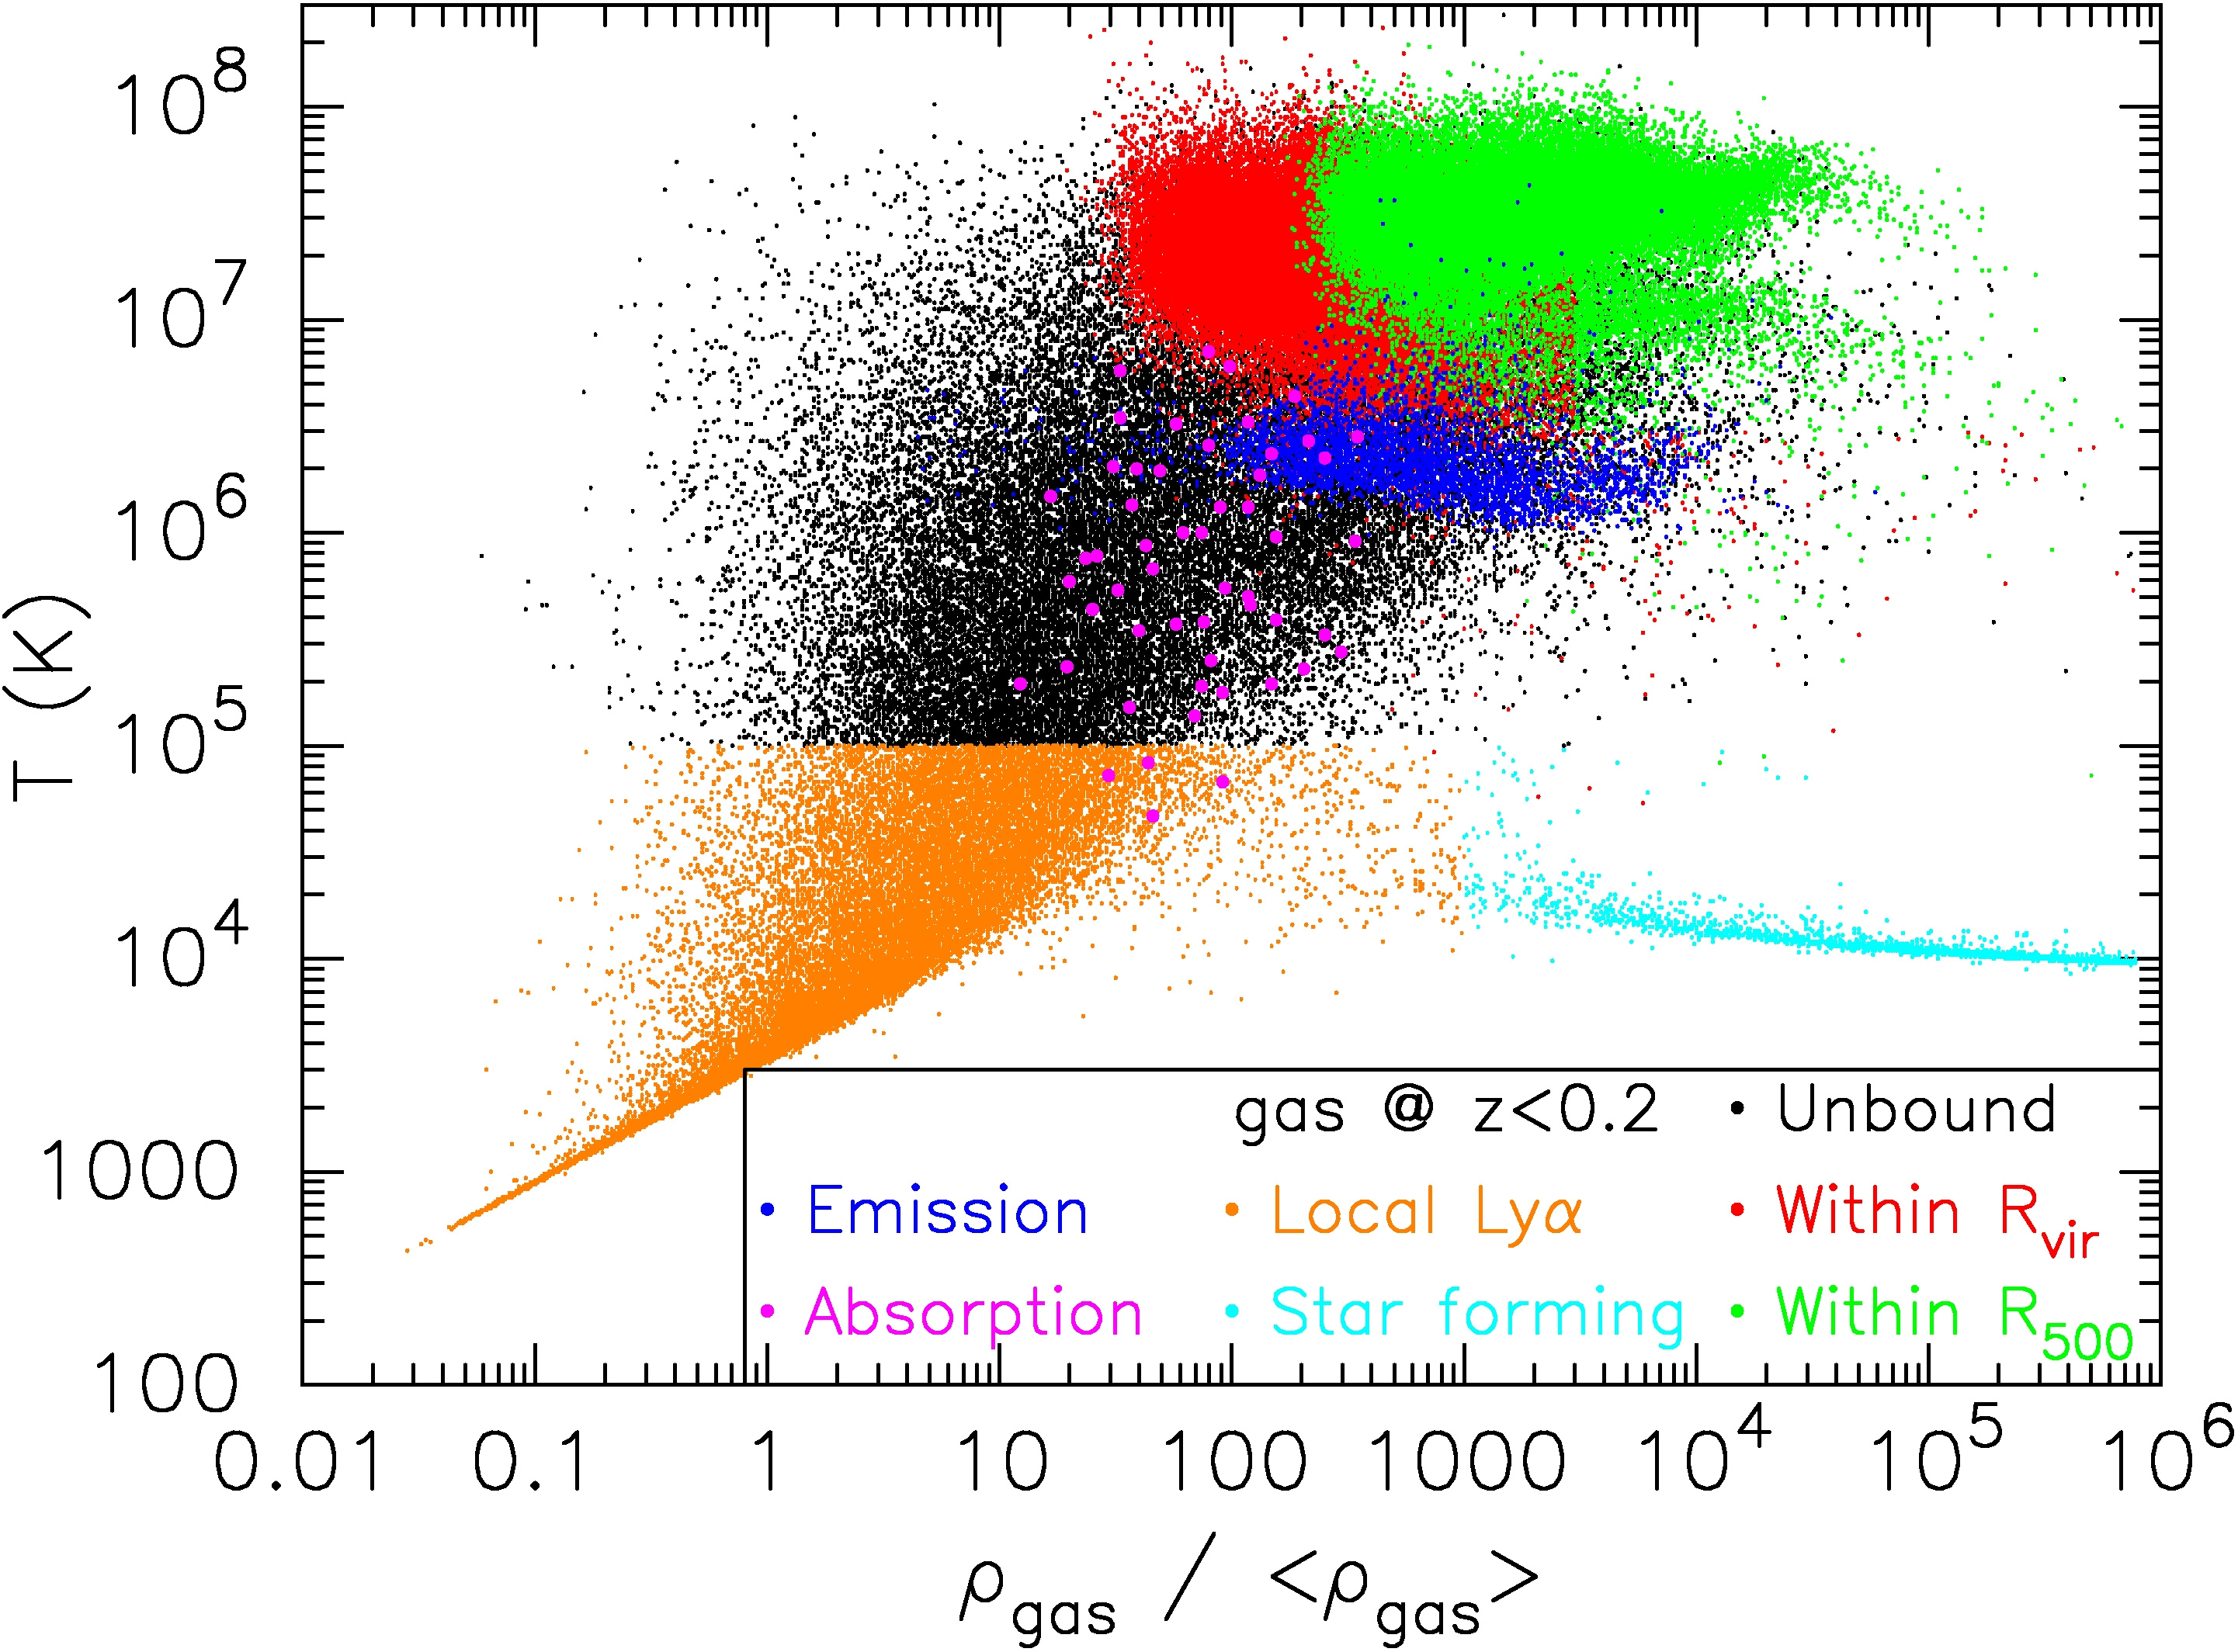
WHIM highly ionized;
at z=0, shocks + X-ray photoionization ionize O up to He- and H-like
➔unique spectroscopic signature in X-ray transitions

Slide 5
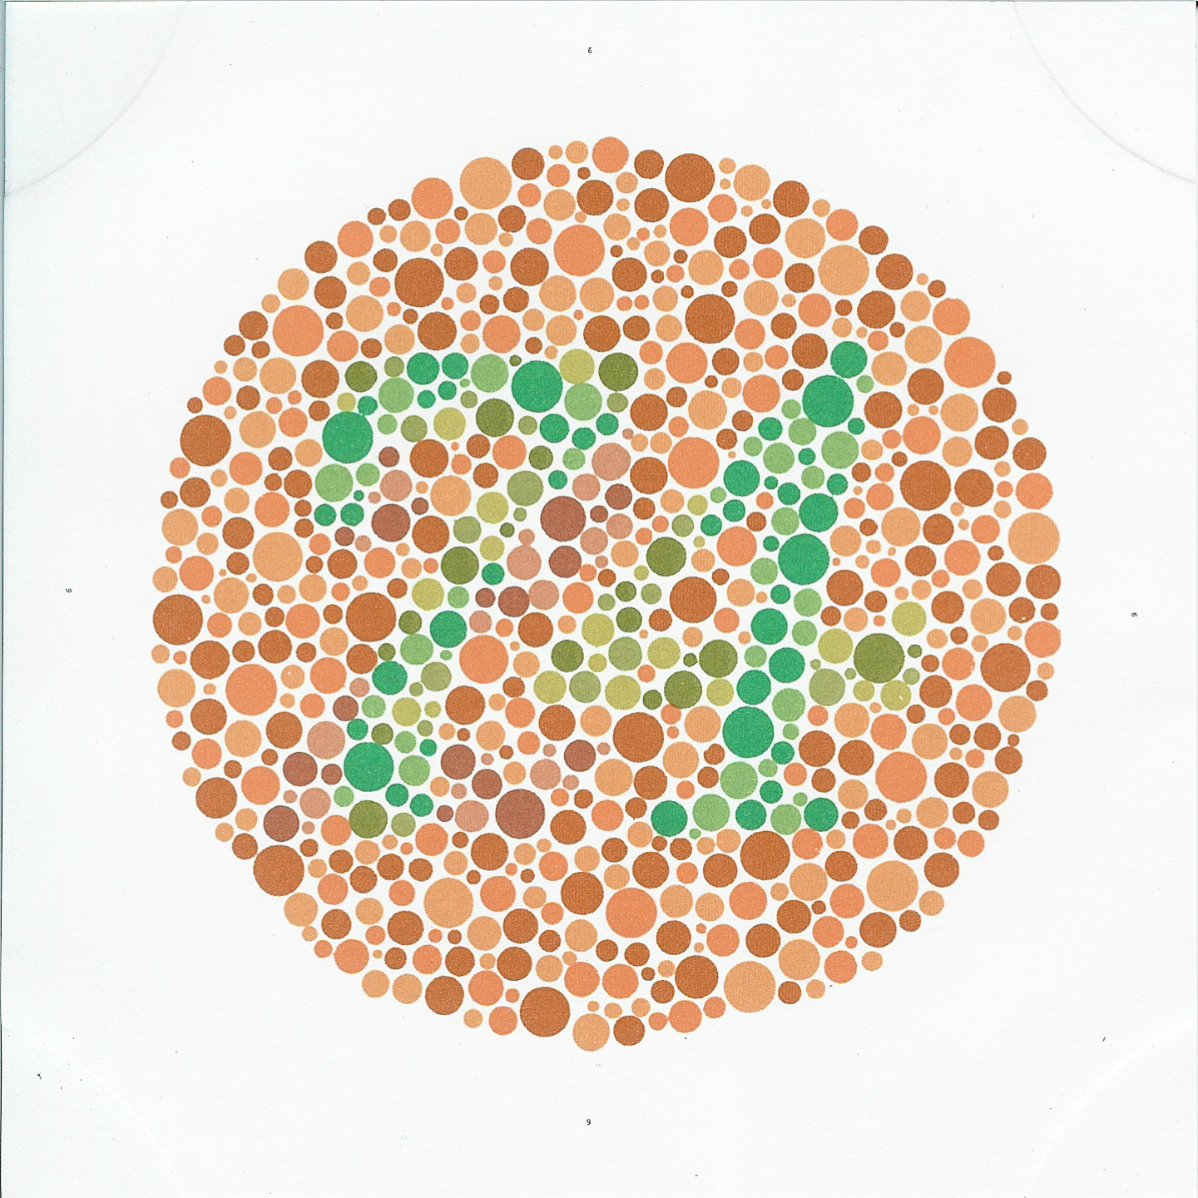
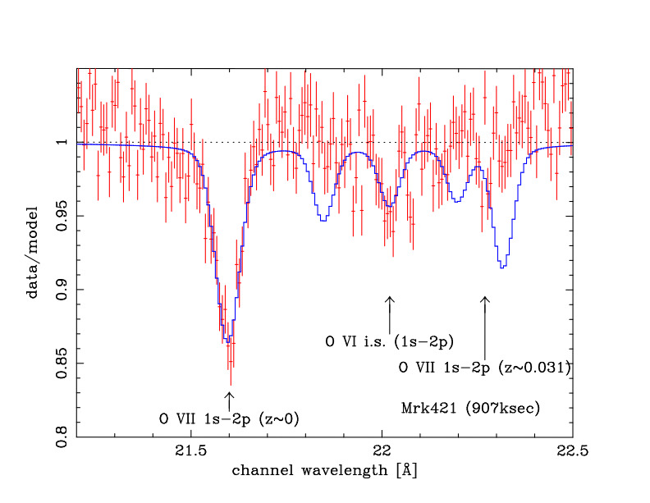
Detection?
Nicastro et al. 2005
Mkn 421 Chandra LETGS
Wavelength (Å)
Rasmussen et al. 2007
Scharf et al., 2000 (ROSAT)
δ ~ 100
XMM RGS
(see also Luca Zappacosta, Alexis
Finoguenov, and Jan Willem den Herder)

Slide 6
2. Deviations from Equilibrium
Physical density very low:
many processes out of equilibrium, even over Hubble time
(e-i equilibration, heavy ion ionization equilibrium,
importance of photoionization, radiative cooling, thermal
stability; interesting effects on shock structure? (B!);
particle acceleration, effect of nonthermal e⁻ on ionization
balance and line excitation, ….)
All of these have effects on spectroscopy of heavy ions!

Slide 7
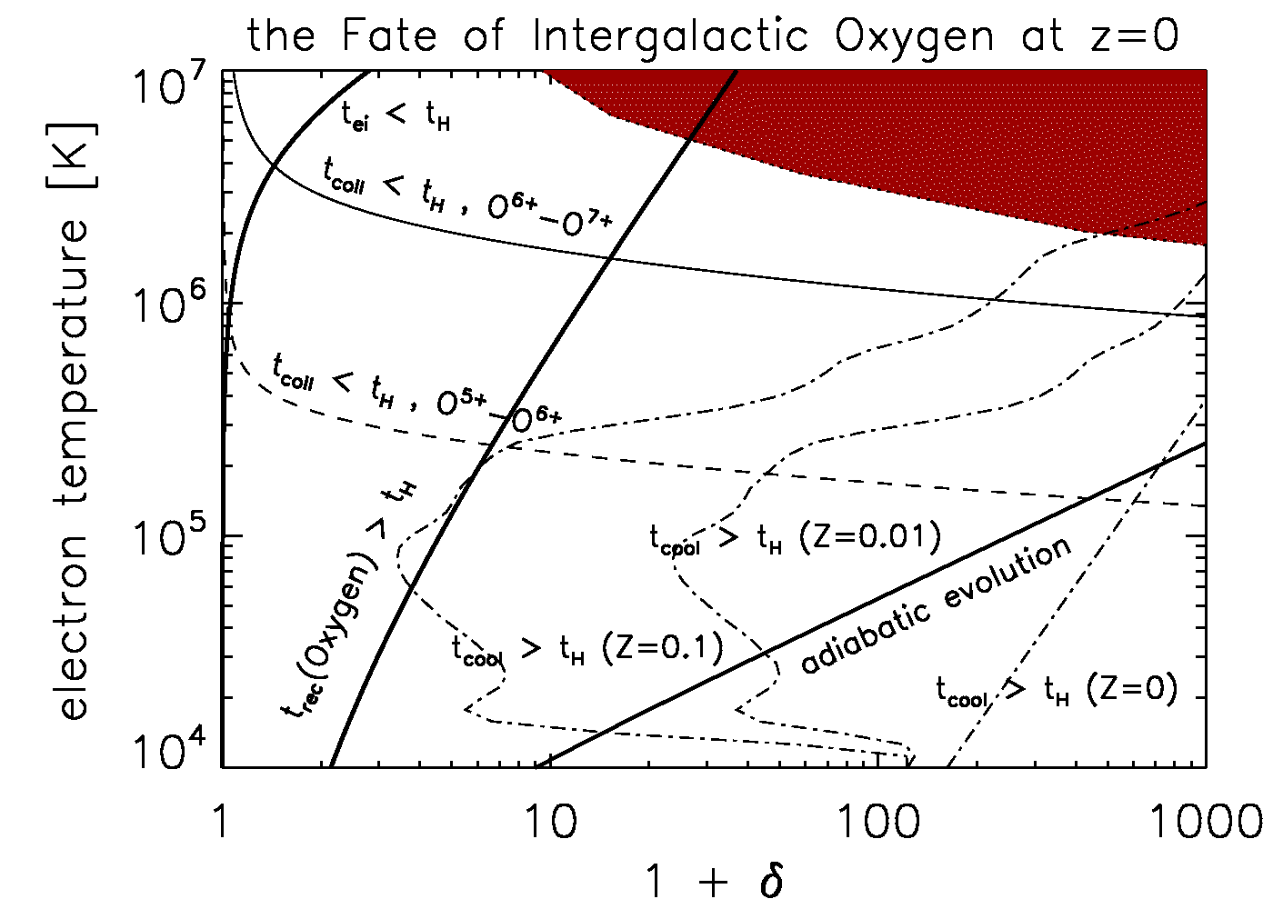

Slide 8
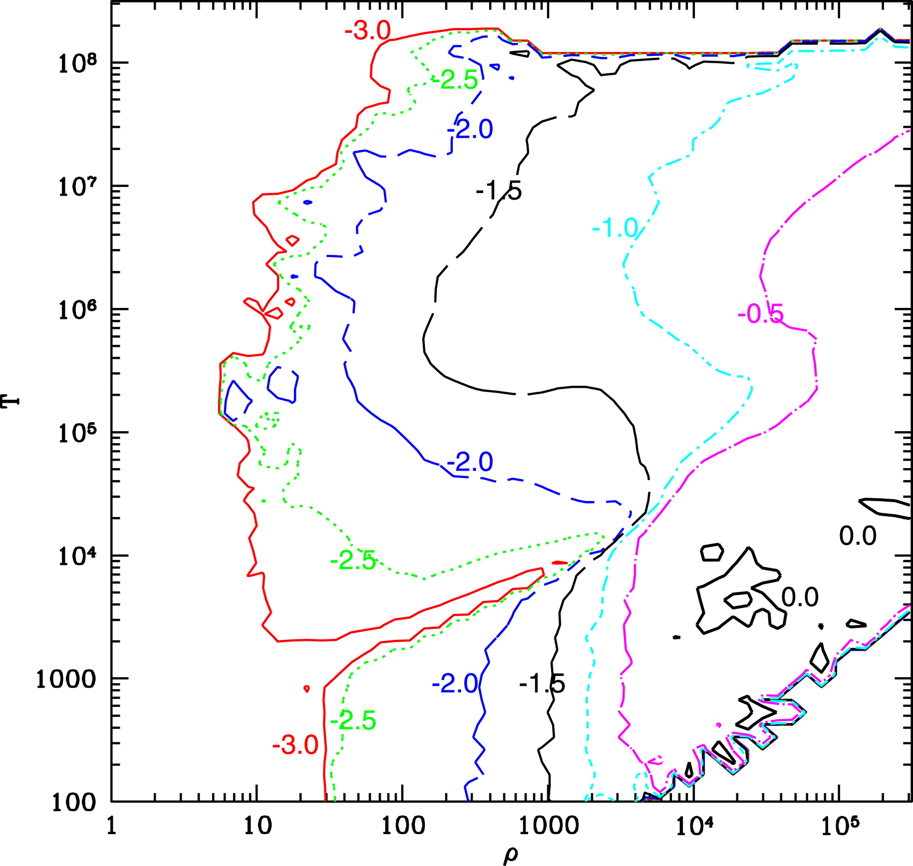
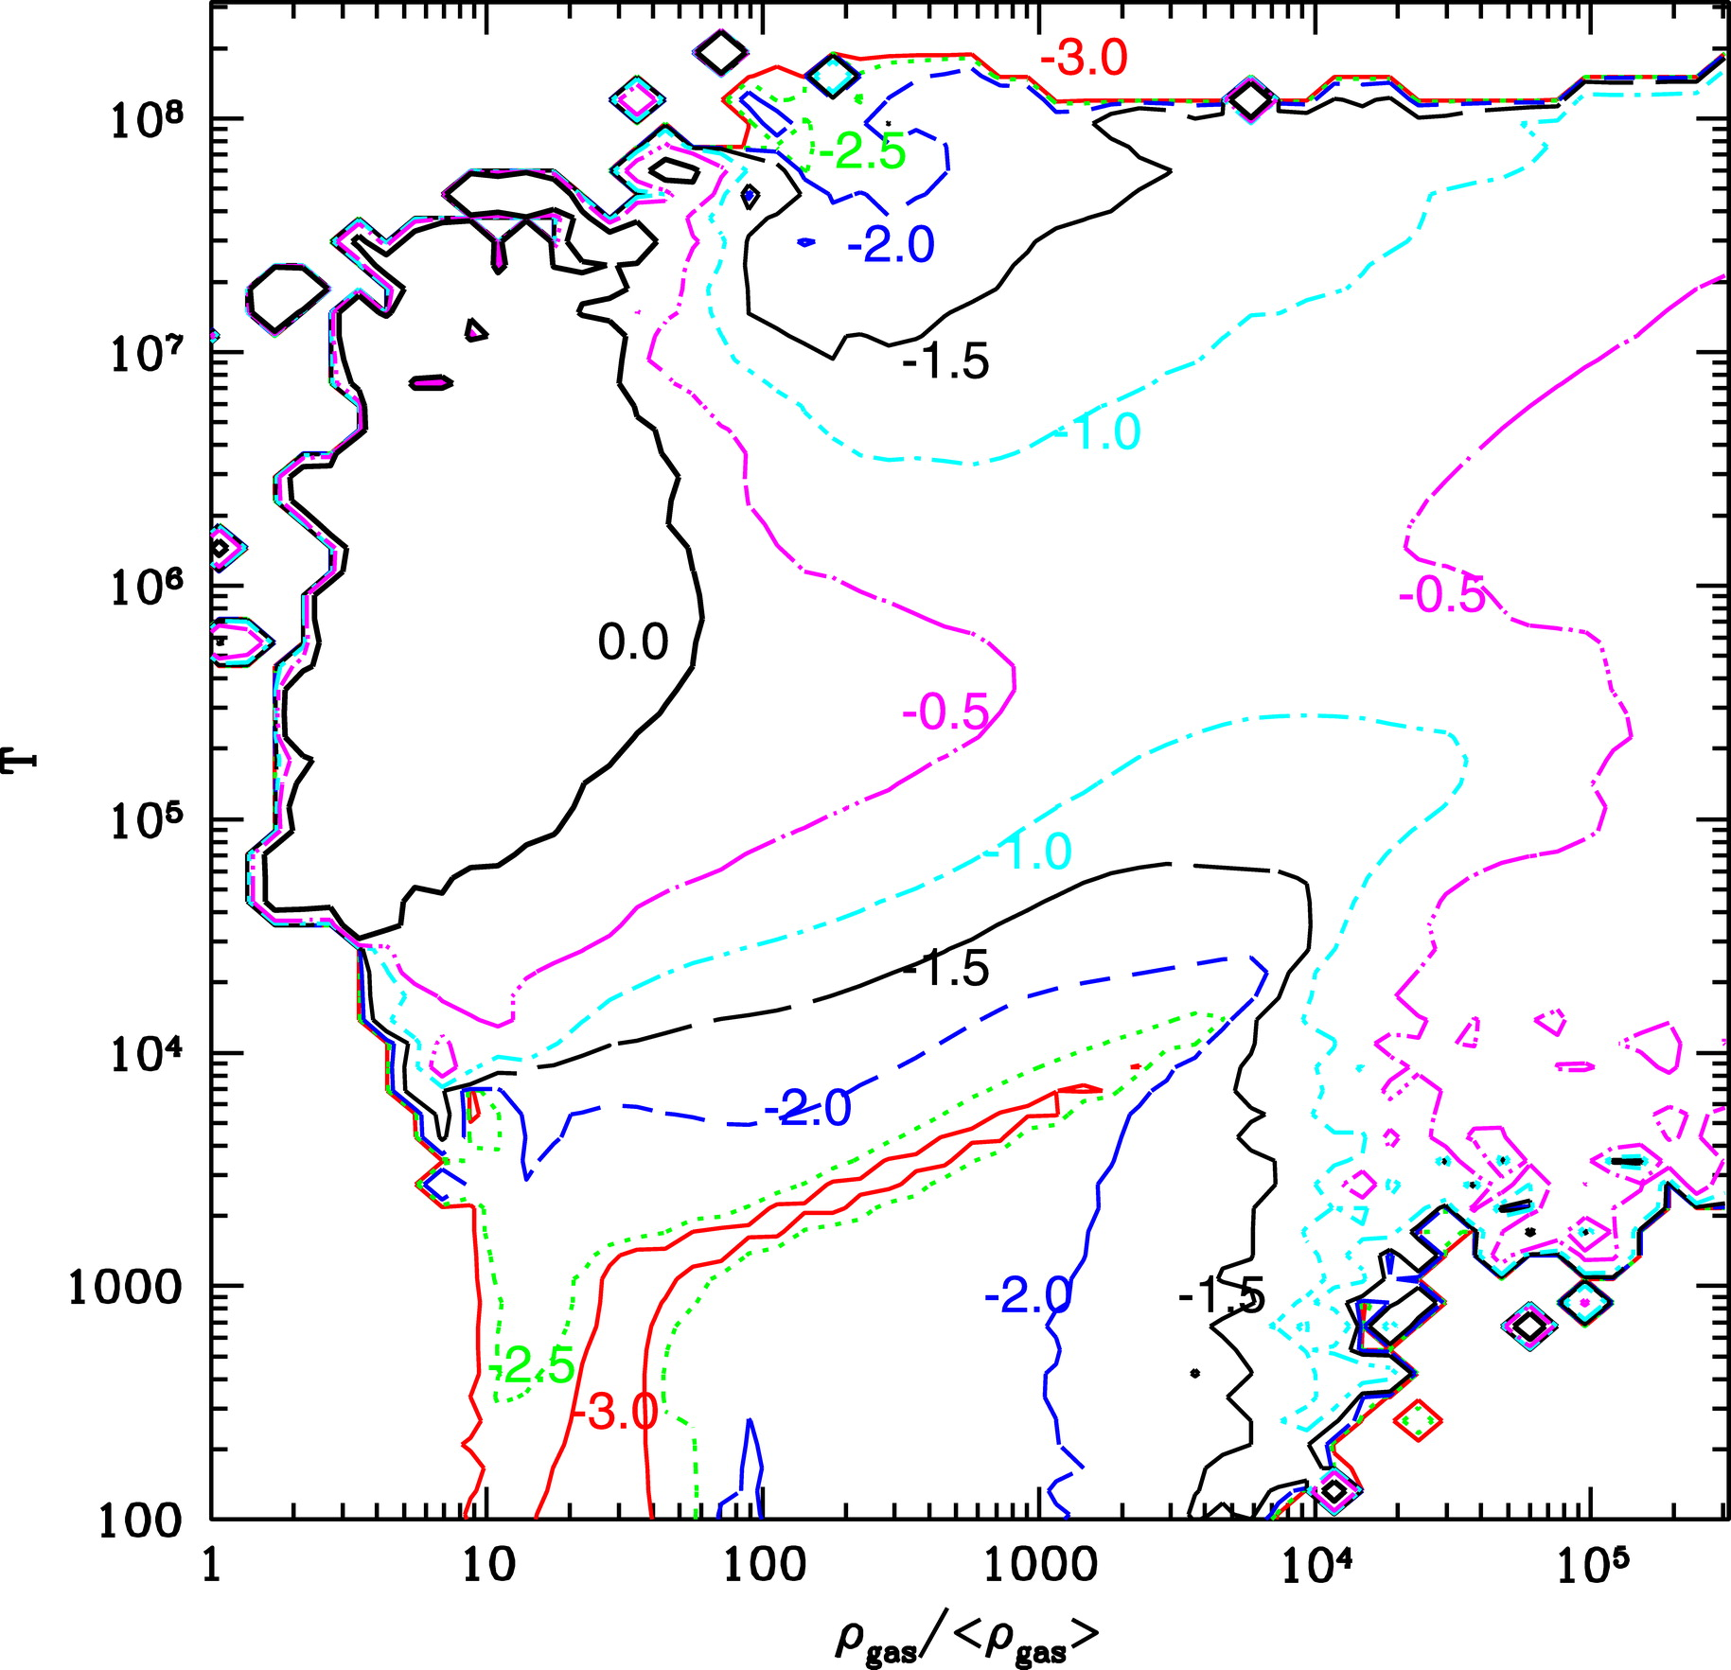
Which WHIM? The effect of Galactic Winds
Without winds
With winds
Cen & Ostriker, 2006

Slide 9
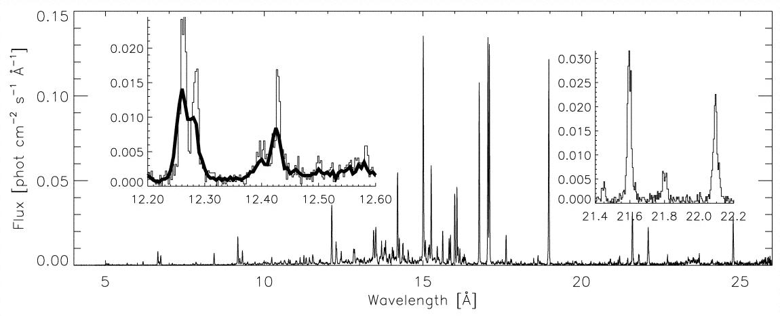
X-ray Spectroscopy and Absolute Measurements
Emission line intensity + absorption line EW: n²L, nL ➔ n, L (for assumed abundance,
ionization balance)
Of special interest: the He-like n=1-2 ‘triplet’; O VII: 21.6, 21.8, 22.1 Å
Intercombination
Resonance
Forbidden
R, I, F line ratio’s sensitive to
excitation mech (CX, rec.),
T_{e}, ionization non-eq., …
Capella, Chandra HETGS (Canizares et al. 2000)

Slide 10
Absolute Abundances
Churazov et al. (2001):
I(forbidden, intercombination): CX, recombination ➔ A n²L
I(resonance): CX, recombination ➔ A n²L PLUS
resonance scattering of CXB continuum➔A nL
If sources of the CX resolved out: WHIM filaments light up in resonance line!
Emission spectroscopy of O VII triplet equivalent to absorption/emission;
At δ = 30, T_{e} = 10⁶ K: scattered/thermal resonance line emission ≈ 2 !
With reasonable assumption for L, get A.
Definite advantage of imaging emission line spectroscopy:
contrast; 3D; estimate absolute densities, abundances
Requirements in terms of spectroscopic resolution: modest (ΔE ~ 2 eV)

